Slide 1
The Sense of Sight

Slide 5
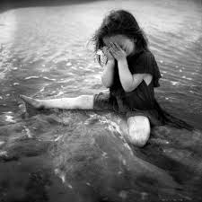

Slide 6
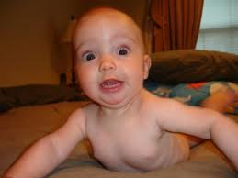

Slide 7
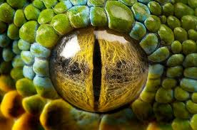

Slide 8
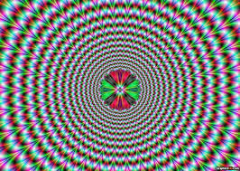

Slide 10
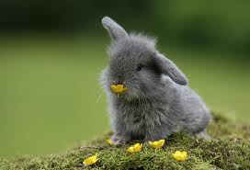

Slide 11
List your two favorite pictures from the power point. Tell what your reaction to the picture was.
Example: I like image number 4 and 3 because I don’t like the scary woods and when my dad gets angry I don’t like it. Mrs. Sarff

